Slide 1

IQ Root Technologies
Client Presentation – March 2017

Slide 2
Agenda
What is IQ Root Technologies
Who are we
Our value proposition
Our Products/Services
Want to create value to Clients!

Slide 3
Introduction to IQ Root Technologies
Mission: Enable humanity for better livelihood through Technology
Values: Excellent Customer Experience, Great Partner Relationship and Best Team working on next generation technologies.
Capabilities: Embedded Systems (HW/SW), Mobile Apps, Internet of Things (IoT), Cloud Technologies, Windows Applications, UI development, System Architecture & Big Data/Data Analytics.
Competencies: C, C++, MFC, COM, ATL, C#, VLSI, FPGA, BSP, Java, JSON, ASP.NET, HTML5, CSS3, MySQL, ServiceNow.

Slide 4
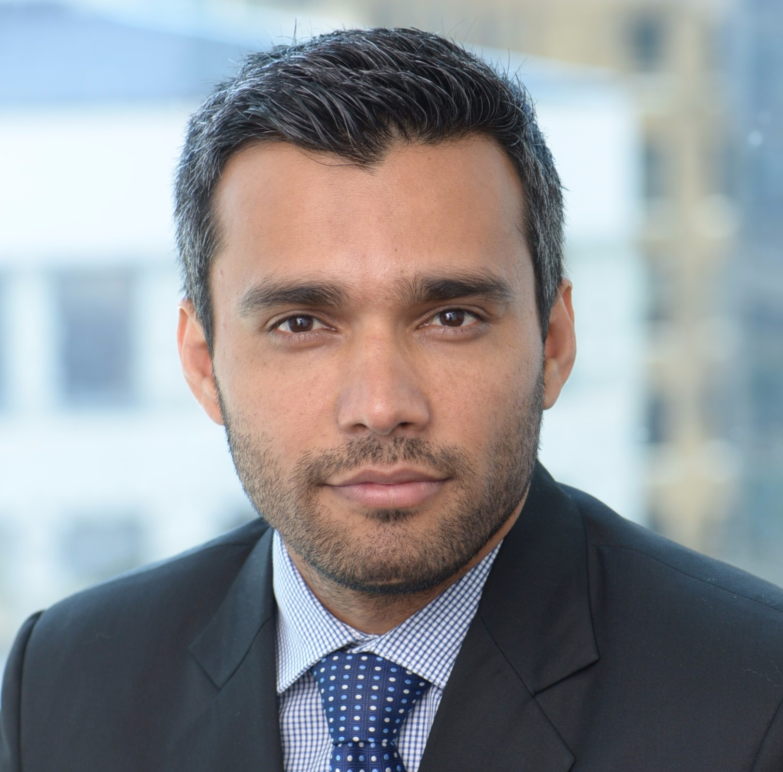
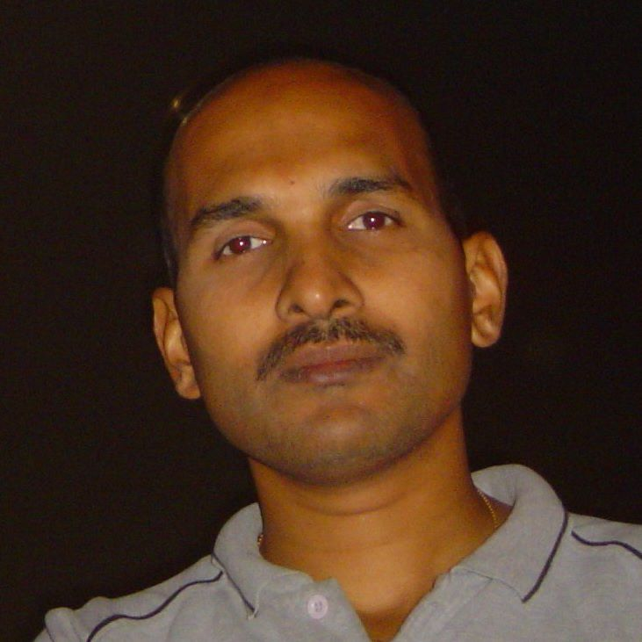
Who Are We?
Vijay Ranganathapura Co-Founder & Chief Executive Officer (CEO)
15+ years global experience in North America, Europe & Asia across 8 diverse industries. Had incorporated, managed and sold a successful business for profit before. Have strong expertise in Client Relationship, Tech Strategy, Business Operations, Account, Delivery & Program Management. Have worked with some of the best branded companies globally that include Deloitte, RBC, Siemens, Bosch & Tata. Has an MBA from Schulich School of Business (Toronto) with Leadership Communications course form Harvard School (Boston).
20+ years global experience in Europe & Asia (India/Japan) across diverse industries. Has certification from a top MNC as “Software Architect”. Has incorporated a new venture on Home Automation. Have strong technology experience on Embedded Systems, Internet of Things (IoT), Windows Applications and Cloud Technologies. Has pioneered few patents through innovative technology Frameworks/ Architectures. Has architected innovative products that were showcased in World Technology Forums.
Mahantesh Ganachari Co-Founder & Chief Technology Officer (CTO)

Slide 5
Why IQ Root Technologies – Value Proposition
Strong proven Management Team with international experience & exposure (NA, Europe & Asia)
Understand Client’s culture and businesses effectively
In-depth expertise on cutting edge technologies
Bright talent team who are capable to translate client’s pain points into excellent business products/ solutions
Quick turnaround capabilities with great quality

Slide 6
Products and Services
Embedded Systems – Strong expertise in both hardware (VLSI/FPGA, BSP) and software product development. Will provide Pre-development Prototypes.
Windows Applications – Rich user interface applications for windows platform.
eCommerce – Currently working on a new idea that would revolutionize the eCommerce business by taking the internet to common people.
Internet of Things (IoT) – Currently working on a new idea to bring IT/OT together with Service Management using IoT.
Mobile App Development – Currently building new Mobile Apps on both IOS and Android platforms to support eCommerce and IoT products.
Big Data/Data Analytics – Currently building Big Data expertise to support eCommerce and IoT products.

Slide 7

Looking for exciting work to address Client’s pain points or unleash potential opportunities to grow Client’s business

Slide 8
Contact us: info@iqroottech.com http://iqroottech.com

